Slide 2
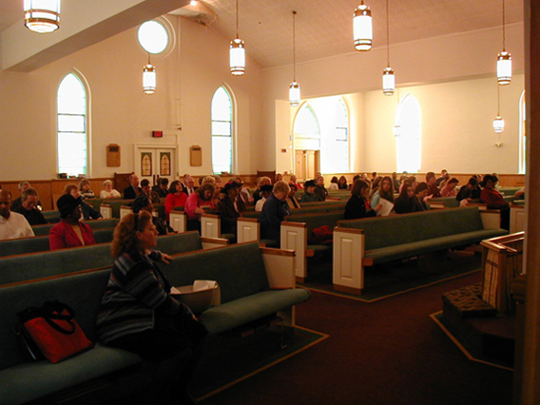
Why you should be present for every service

Slide 3
TO IMITATE JESUS AND OTHERS
43

Slide 4
Saints should imitate the apostles
43

Slide 5
1 Corinthians 11:1
Imitate me, just as I also imitate Christ.

Slide 6
Philippians 3:17
Brethren, join in following my example, and note those who so walk, as you have us for a pattern.

Slide 7
Philippians 4:9
The things which you learned and received and heard and saw in me, these do, and the God of peace will be with you.

Slide 8
Saints should imitate faithful elders and preachers

Slide 9
Hebrews 6:11-12
And we desire that each one of you show the same diligence to the full assurance of hope until the end, that you do not become sluggish, but imitate those who through faith and patience inherit the promises.

Slide 10
Hebrews 13:7
Remember those who rule over you, who have spoken the word of God to you, whose faith follow, considering the outcome of their conduct.

Slide 11
1 Peter 5:2-4
Shepherd the flock of God which is among you, serving as overseers, not by compulsion but willingly, not for dishonest gain but eagerly; nor as being lords over those entrusted to you, but being examples to the flock; and when the Chief Shepherd appears, you will receive the crown of glory that does not fade away.

Slide 12
1 Timothy 4:12
Let no one despise your youth, but be an example to the believers in word, in conduct, in love, in spirit, in faith, in purity.

Slide 13
Saints should imitate Jesus
52

Slide 14
1 Peter 2:21-24
For to this you were called, because Christ also suffered for us, leaving us an example, that you should follow His steps: "Who committed no sin, Nor was deceit found in His mouth"; who, when He was reviled, did not revile in return; when He suffered, He did not threaten, but committed Himself to Him who judges righteously; who Himself bore our sins in His own body on the tree, that we, having died to sins, might live for righteousness--by whose stripes you were healed.

Slide 15
Galatians 2:20
I have been crucified with Christ; it is no longer I who live, but Christ lives in me; and the life which I now live in the flesh I live by faith in the Son of God, who loved me and gave Himself for me.

Slide 16
Matthew 4:23
And Jesus went about all Galilee, teaching in their synagogues, preaching the gospel of the kingdom, and healing all kinds of sickness and all kinds of disease among the people.

Slide 17
Matthew 9:35
Then Jesus went about all the cities and villages, teaching in their synagogues, preaching the gospel of the kingdom, and healing every sickness and every disease among the people.

Slide 18
Matthew 13:54
And when He had come to His own country, He taught them in their synagogue, so that they were astonished and said, "Where did this Man get this wisdom and these mighty works?"

Slide 19
Matthew 18:20
"For where two or three are gathered together in My name, I am there in the midst of them."

Slide 20
Luke 4:15-16
And He taught in their synagogues, being glorified by all. So He came to Nazareth, where He had been brought up. And as His custom was, He went into the synagogue on the Sabbath day, and stood up to read.

Slide 21
John 18:20
Jesus answered him, "I spoke openly to the world. I always taught in synagogues and in the temple, where the Jews always meet, and in secret I have said nothing."

